Slide 1

Florida Real Estate and Rising Sea level
Maggi Vidal NSS DDA3 Capstone 4/30/2021

Slide 2

Sea Level Rise

Slide 3
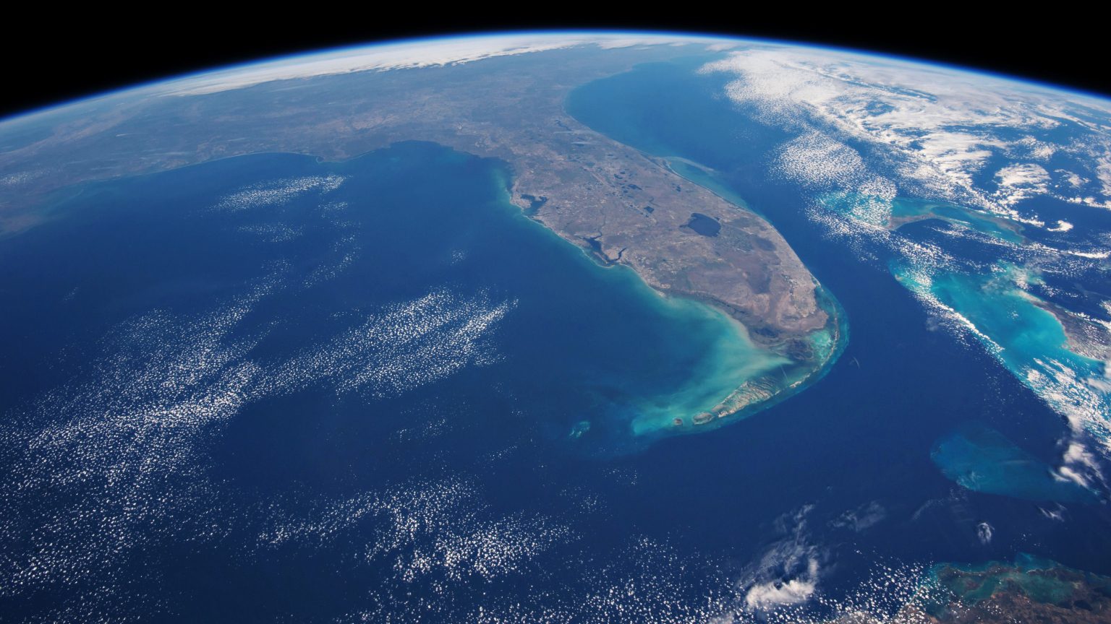
Flooding

Slide 4
Flooding
Significant Florida Floods
Cape Sable Hurricane of 1947
Hurricane Dora 1964
Okeechobee Hurricane of 1928
Tropical Storm Debby 2012
Tropical Storm Fay 2008
https://www.weather.gov/safety/flood-states-fl

Slide 5
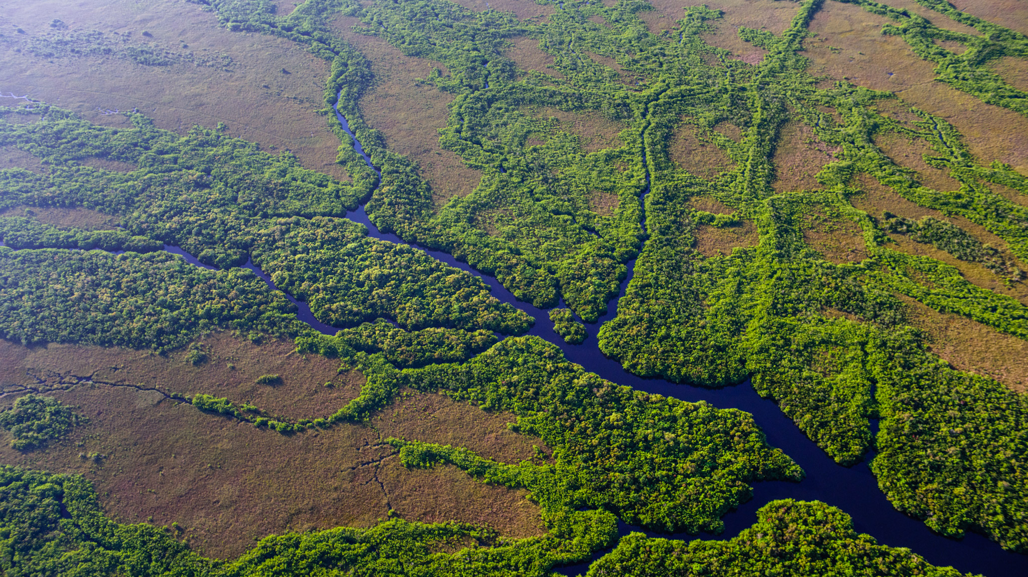
Florida Elevation Map

Slide 6
https://www.sun-sentinel.com/opinion/commentary/fl-op-com-flood-threat-florida-homeowners-20190808-zwd74xxebvav3b7y65qsrqlwlu-story.html

Slide 7

Transition slide

Slide 8

Transition slide– Census Data

Slide 9

Census Population Data

Slide 10

beach

Slide 11

swamp

